Slide 1

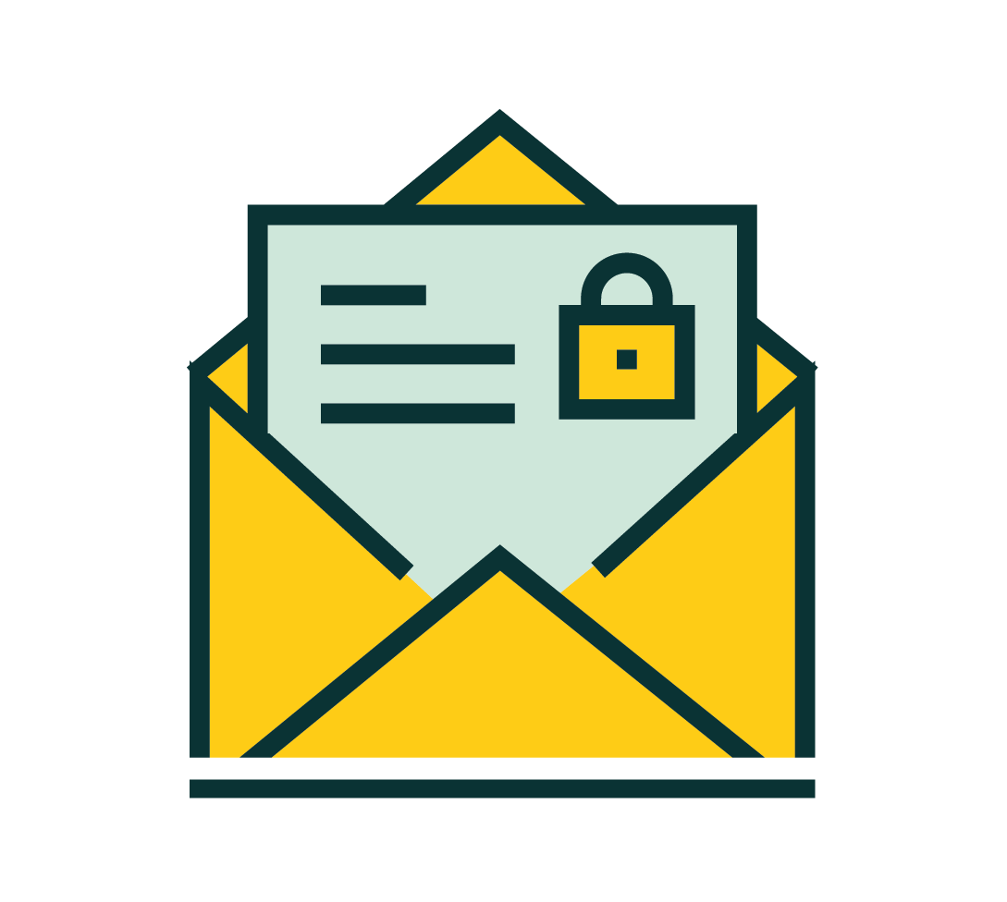
Email
Encryption

Slide 2

Open Technology Workshops
SERVICES
Email Encryption

Slide 3
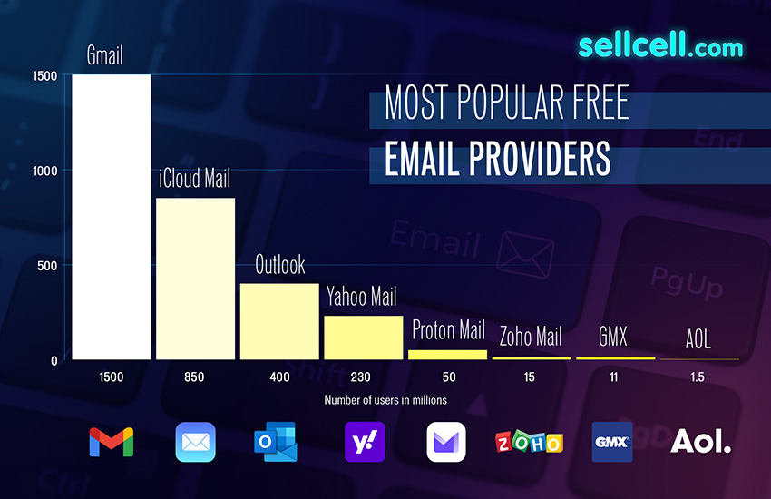
Why Encrypt?
Email is the beginning of your online identity.
Many common email services sell your data to advertisers (like Gmail and Yahoo) or perpetuate monopolistic power (like Microsoft and Apple) to lock you into their ecosystem.
Remember that businesses do not offer services completely for free. You or someone else is still paying for it.

Slide 4
Email Security Explained
...email is best used for receiving transactional emails (like notifications, verification emails, password resets, etc.) from the services you sign up for online, not for communicating with others.
~ PrivacyGuides.org
Encrypted email services are great, but email itself is still not private.
In motion… Email was not built to be private or anonymous, although there have been many improvements to its security over time (SSL/TLS). | Solution: Access email through SSL/TLS (already supported in most clients).
At rest… Email stored on a server can still be accessed by mined by the provider. | Solution: Use encrypted email services

Slide 5



The cost of “free” email
Who owns your email?
Alphabet Inc. | Microsoft Corporation | Apple Inc.
15 GB storage Price: $0 and your privacy. | 15 GB email storage 5 GB cloud storage Price: $0 and your privacy. | 5 GB storage Price: $0 and vendor lock-in.

Slide 6


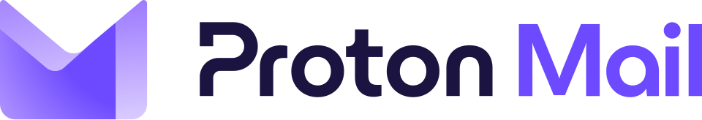
Comparison
Switch to one of these providers recommended by Privacy Guides!
https://www.privacyguides.org/en/email/
Based in Switzerland Can work with other clients through ProtonBridge MFA: TOTP and hardware keys Can also use OpenPGP keys | Based in Berlin, Germany Can work with other clients through ProtonBridge Supports custom domains MFA: TOTP and hardware keys Can also use OpenPGP keys | Based in Hanover, Germany Does not use OpenPGP keys Offers business version for free to non-profits Can start account anonymously Quantum-safe encryption

Slide 7
Using OpenPGP with your email provider
Follow along kids!
https://www.amarketplaceofideas.com/install-thunderbird-email-client-configure-pgp-rsa-public-private-key-encryption.htm

Slide 8
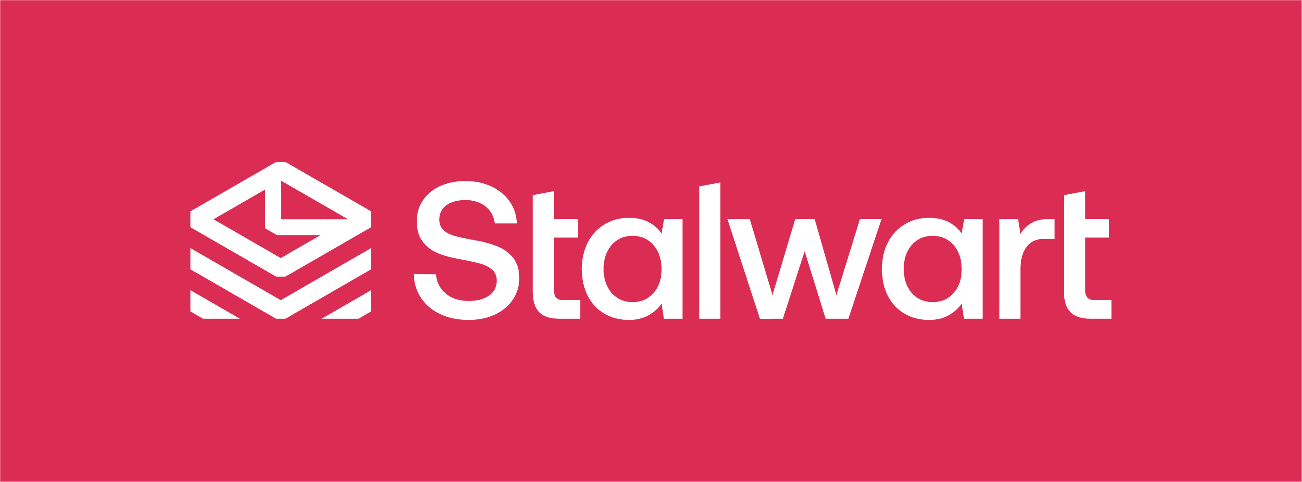
Hosting your own ProtonMail
Stalwart Mail is an all-in-one email server that runs in a single Docker container.
LibreTechnica’s Sovereign Tech Stack Project provides a guide to self-hosting Stalwart Mail at: https://sts.libretechnica.org/infra/stalwartmail/
How to use PGP keys with Stalwart: https://stalw.art/docs/encryption/pgp/

Slide 9

Honorable Mention
Mailvelops is a browser extension that lets you manage OpenPGP keys and use with your webmail.
It looks pretty neat, but I haven’t tried it out yet. Here’s how it’s used with Nextcloud:
https://www.youtube.com/watch?v=2gvkH_DwkPI

Slide 10


Extra Features
An email aliasing service allows you to easily generate a new email address for every website you register for. Email going to these aliases are then forwarded to an email address of your choosing, hiding both your "main" email address and the identity of your email provider.
Simplelogin (owned by Protonmail) and addio.io are great email aliasing services that can help reduce junk in your inbox and tracking.
Ref: https://www.privacyguides.org/en/email-aliasing/

Slide 11
Where to find out more
More resources
https://search.libretechnica.org
https://www.privacyguides.org/
  https://www.privacyguides.org/en/basics/common-threats/#privacy-from-service-providers
  https://www.privacyguides.org/en/basics/email-security
  https://www.privacyguides.org/en/basics/account-creation/
https://en.wikipedia.org/wiki/Email_encryption
https://libretechni.ca/

Slide 12
Fin
Remember: Maintain OPSEC and good digital hygene practices!!!
Thank you for coming!

